Slide 1
FARMERS’ DIALOGUE
International
Where farmers renew their calling
to feed the world
-Claude Bourdin / October 2018

Slide 2

Farmers’ Dialogue and « Initiatives of Change »
Be the change you want to see in the world!
There is enough on earth for everyone’s
needs, but not for everyone’s greed.
As a farmer I commit myself to take
decisions on a basis of openness and honesty.
We are stewards of the soil and plan to pass
it on in better condition to coming generations!

Slide 3
Ove Jensen

Slide 4
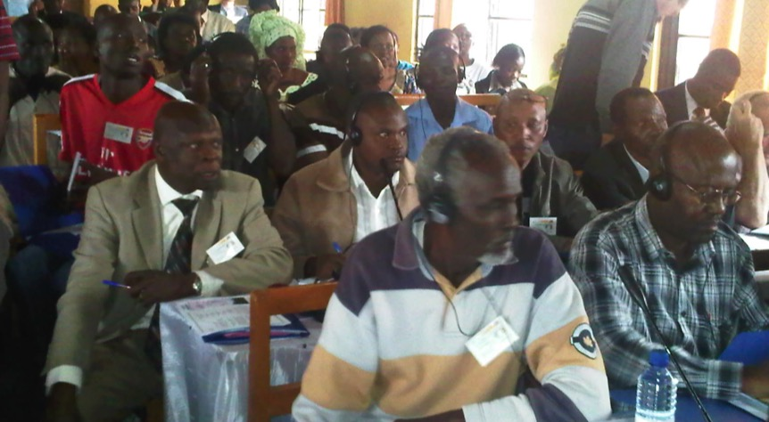
Exchanges between farmers

Slide 5
Farmers’ Dialogue - Approach
Farmers share their experiences
Field visits
Dialogues
International network of farmers
Tools for information and communication
Be the change you want to see in the world!

Slide 6
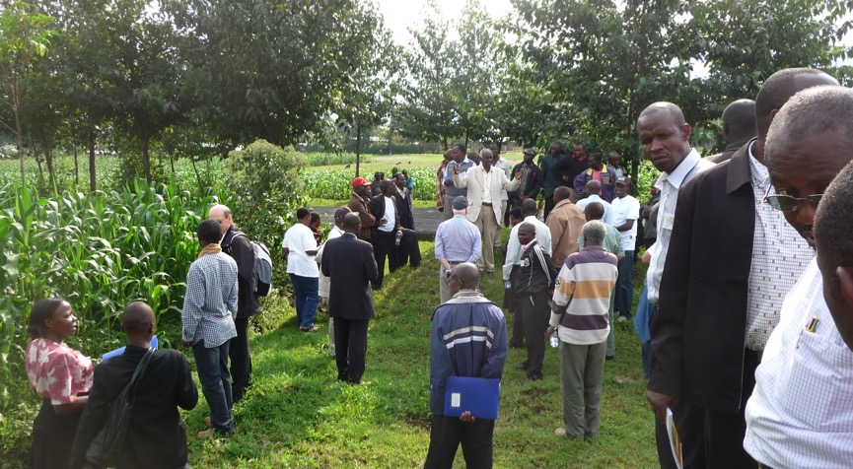
Field Visits

Slide 7
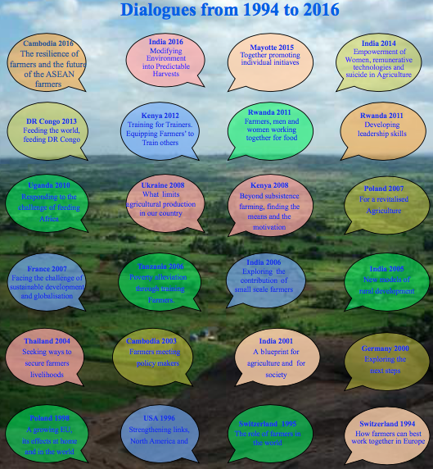
International Dialogues

Slide 8
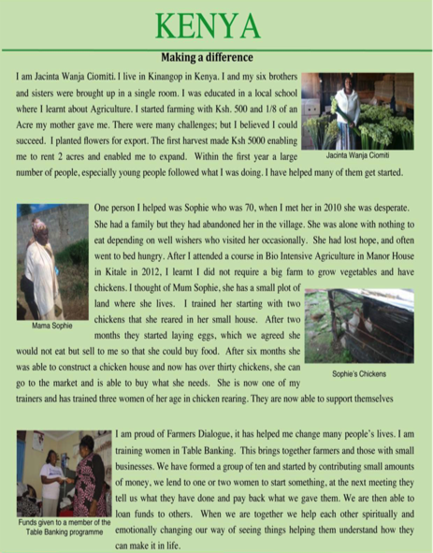
Personal
Stories

Slide 9
MISSION
- To produce the food needed.
- To care for natural resources.
- To receive a fair return for their work.
- To have their voices heard.
- To contribute to global decision-making process.

Slide 10
Farmers’ Dialogue General Framework
Sustainable Development Goals
(SDG of United Nations)
n° 1 and 2: No poverty – Zero hunger
n° 11: Sustainable cities and communities
n° 13 -15: Climate action – Life on land
n° 17: Global partnership for sustainable development
The Principles and Aims of the Association
« Initiatives of Change International »,
and particularly its « Initiative for Land, Lives and Peace »

Slide 11
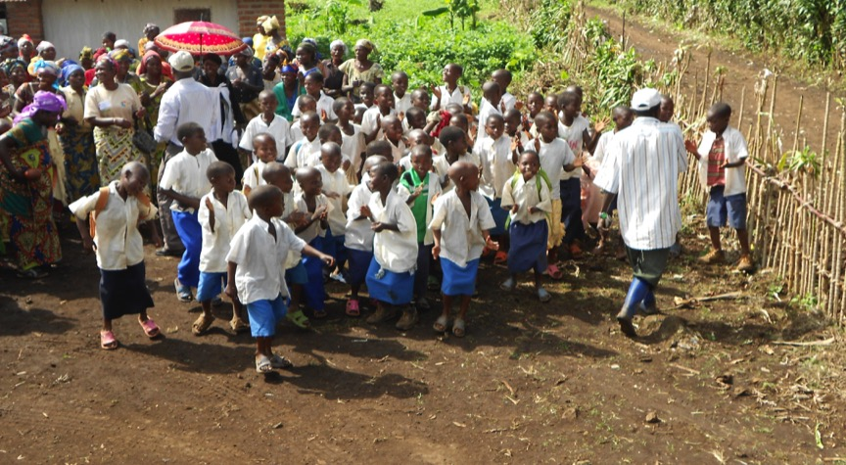
To rehabilitate through agriculture, to feed the world

Slide 12
The Major Current Issues
Poverty
Food production for an increasing global population
Care for the environment
Farmers are in the front line
to contribute with solutions
to each of these challenges

Slide 13
Farmers Facing Their Calling
Teamwork between farmers
Professional common organisations
Simple and practical technical solutions
Marketing
What hinders the farmers?
Where are the resistances?
What obstacles are there?

Slide 14
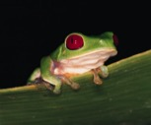

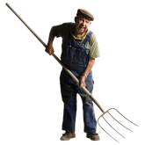


SILENCE, I am thinking!
I take time in silence,
I look at my life,
I compare it with my ideals, …
Need of light ?
What needs to be unlocked?
Useless? Get rid of it!

Slide 15
HUSH …! ! !
Quiet !

Slide 16

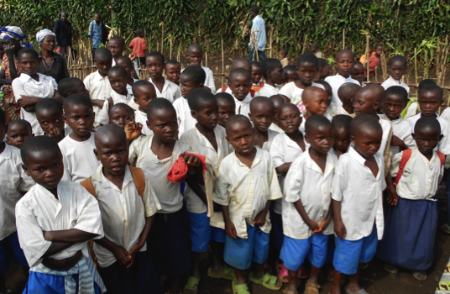
Change – Motivation – Commitment
It’s my turn !
So many needs!
Which decision?

Slide 17
COMMUNICATION
FDI email : Internationalfd@iofc.org
Site Internet : www.farmersdialogue.org
Facebook DEA : www.fb.com/FarmersDialogue

